Slide 1

Frito-Lay, Inc. Case Study: Factors of Employee Attrition
DDS Analytics
December 9, 2023

Slide 2

Case Study Objectives
Identify factors leading to attrition
Identify job role specific trends
Provide interesting trends and observations from exploratory analysis
Build a AIML model to predict attrition
Develop an interactive R Shiny App

Slide 3

Project Deliverables
CaseStudy2DDS GitHub Repository
GitHub Jekyll Page
PowerPoint Presentation
Executive Summary
R Statistical Analysis
R Shiny App
Case Study Predictions

Slide 4

Profile: Company Snapshot
PepsiCo, Inc.

Slide 5

Executive Summary
Frito-Lay, a division of PepsiCo, has a rich heritage dating back to the 1930s, stemming from the merger of The Frito Company and H.W. Lay & Company. This merger created a snack food giant with a diverse portfolio of beloved brands like Fritos, Lay's, Cheetos, Doritos, and Tostitos. The company's significant growth led to a merger with Pepsi-Cola in 1965, forming PepsiCo. Today, Frito-Lay is a market leader with a strong commitment to sustainability and innovation. It continually invests in technology to enhance its manufacturing processes, ensuring wide accessibility to its products. Frito-Lay's ongoing success is marked by its extensive range of products and its strategic vision for future growth and sustainability.
Founded August 28, 1898
Global HQ Harrison, New York
Executive Team
CEO Ramon Laguarta
CFO Hugh Johnston
Financials
Market Cap $227B
Revenue $86B (2022)
Website
pepsico.com

Slide 6

Background Introduction
DDS Analytics

Slide 7
Introduction
Name, occupation, company profile information and the task given
Familiarize with project file structure
Explain how reproducible research methods were gathered
List the packages installed, libraries used

Slide 8

Dataset
Part I

Slide 9

Import
General Overview of Case Study Datasets
Process of Importing Dataset
AWS Public Key Security vulnerability

Slide 10

Tidy
Discuss Missing Data Relevant to Study
Describe the Types of Data Classes
Finding Missing or NaN data
Considerations:
Ambiguous values
Ambiguous variables
Unused variables

Slide 11

Exploratory Data Analysis
Part II

Slide 12
EDA Plots
140 Attrition
job specific role trends
histogram, boxplot, scatterplot
Job Role, Job Satisfaction, Monthly Income Positively Skewed (Right-skewed)
Unremarkable, generally uniform across the three variables
No apparent correlation between Job function, pay and happiness in the workplace
Example: Relatively same distribution of Lab Techs in all categories of Job Satisfaction
Expanding search to other factors like distance, job mobility,
Job roles with senior positions appear to have lower rates of attrition
Higher rates of attrition for women working in HC, HR, Mgmt, Sales Rep wrt Male working in same role; suggests higher rate of job dissatisfaction in company where there is a demand for employee/client facing roles
contributing factors leading to attrition
Hypothesis testing

Slide 13
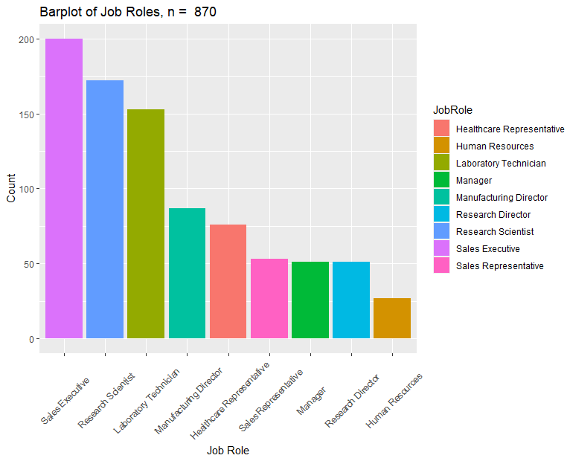

Slide 14
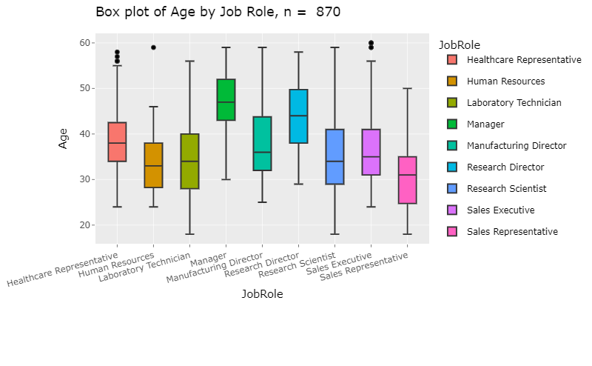
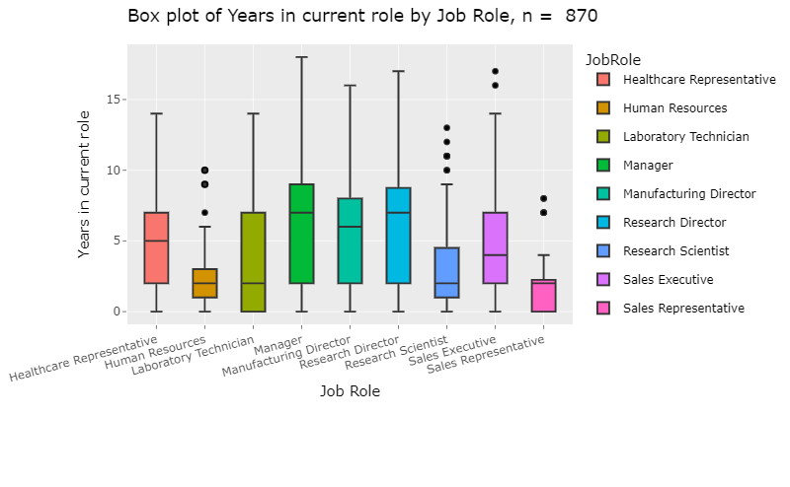
Company Snapshot by Job Roles
Age
Years in Current Role

Slide 15
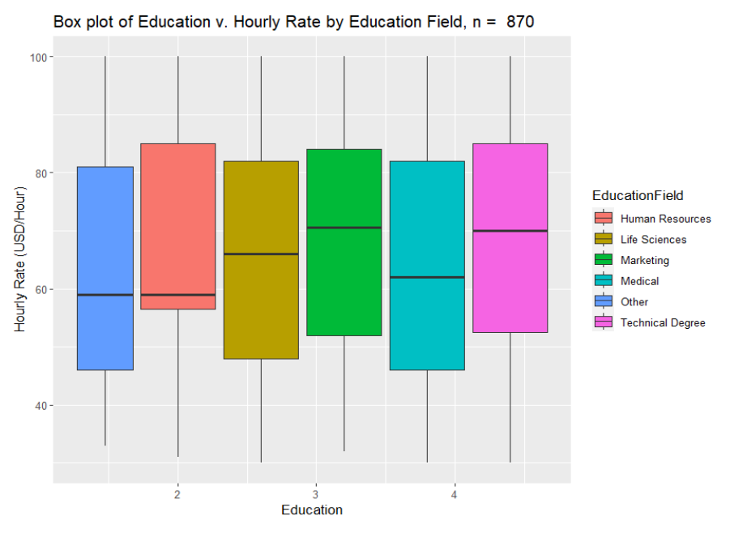
Dispersion of Education & Wealth

Slide 16
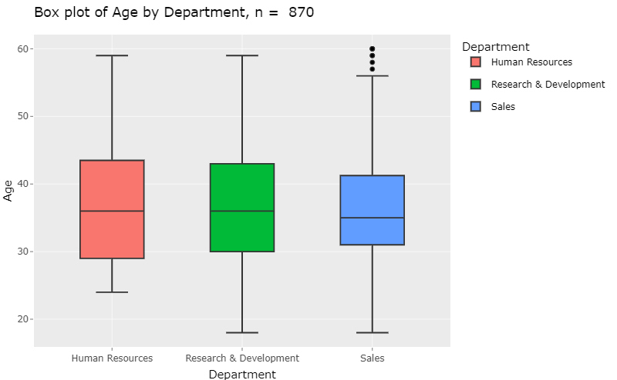
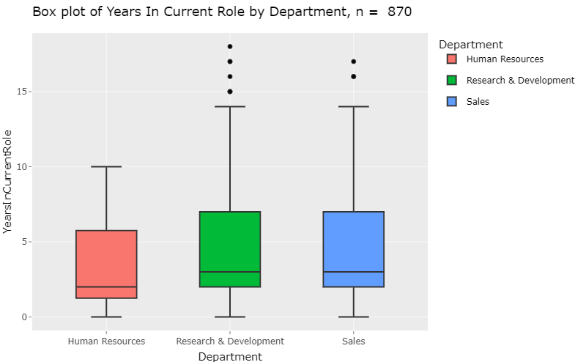
Employee Department Metrics
Age
Years in Current Role

Slide 17
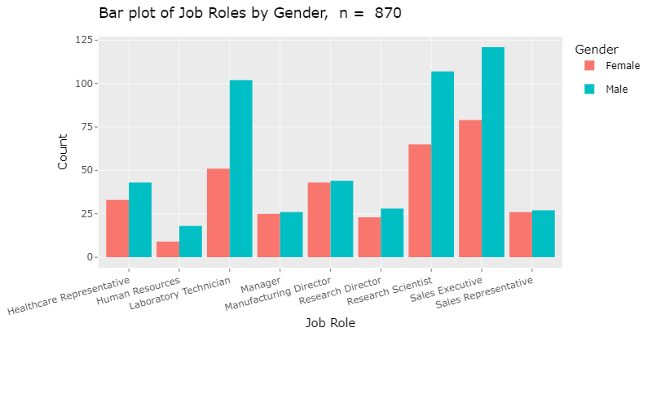
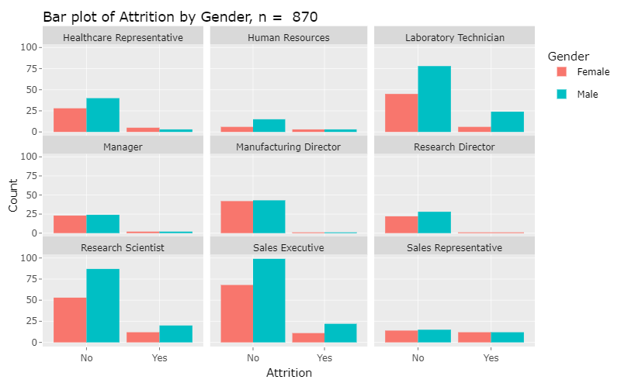
M-F Gender Comparison: Job Role v. Attrition

Slide 18
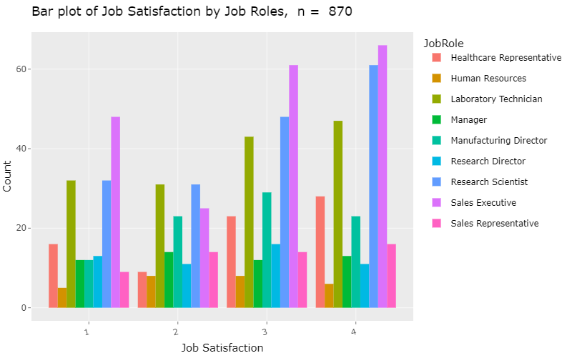

Slide 19
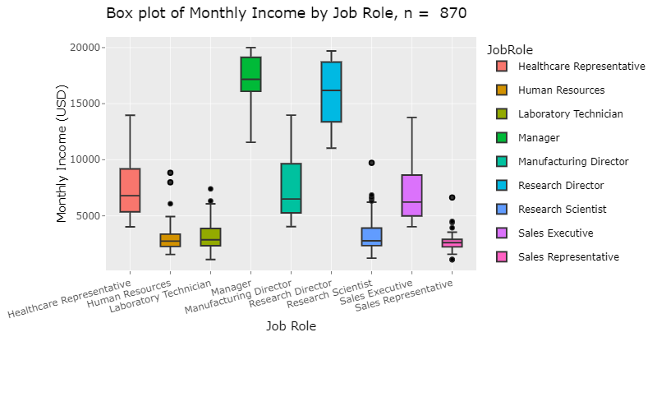
Monthly Income Spread by Job Role

Slide 20
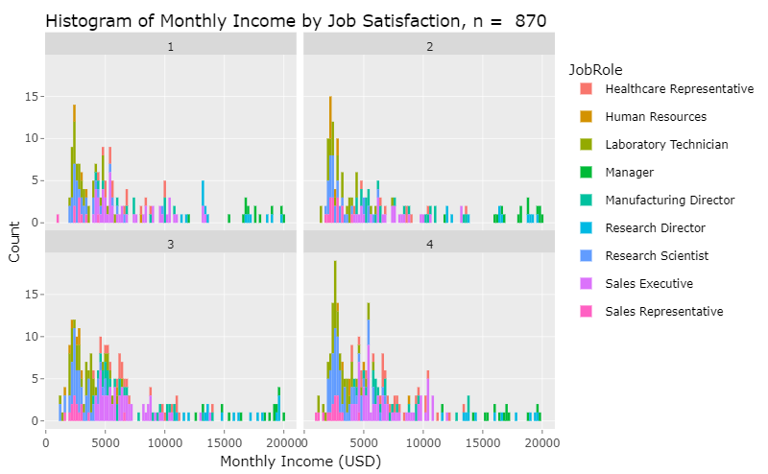
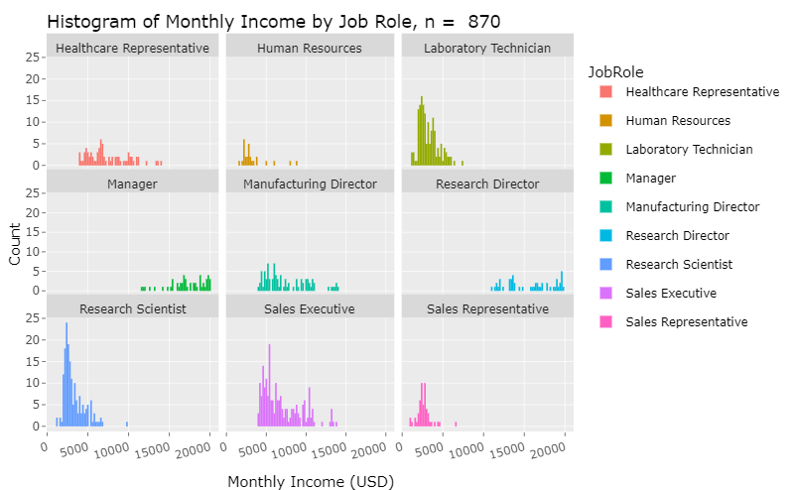
Monthly Income Comparison
Monthly Income Relatively Uniform with respect to Job Satisfaction

Slide 21

Modeling
Part III
Classification and Prediction

Slide 22
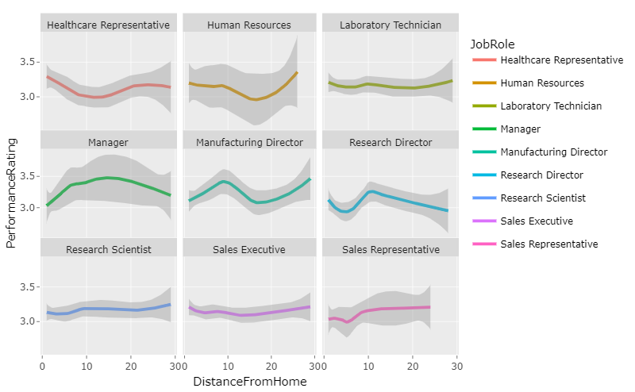
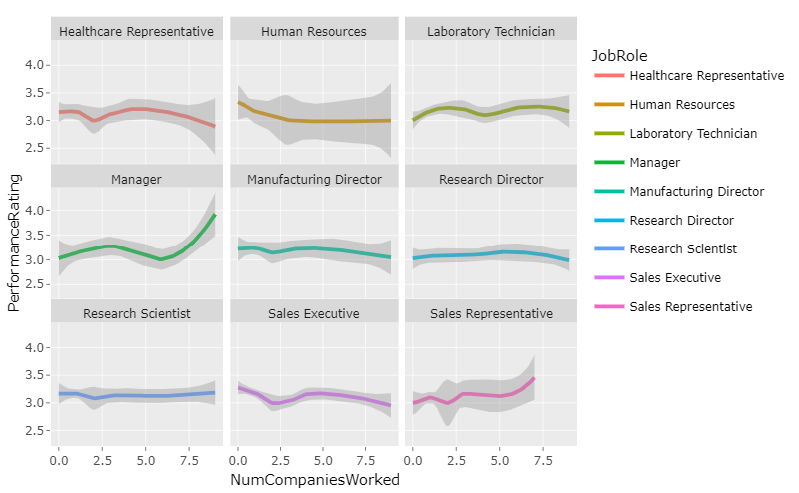
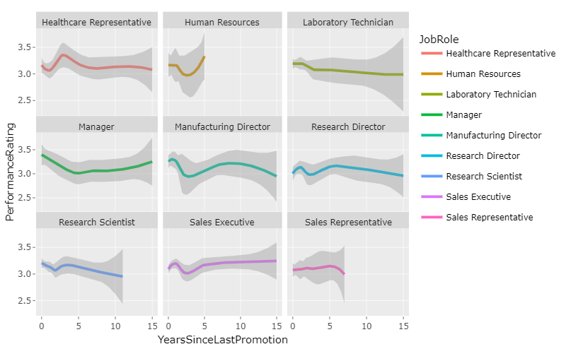

Slide 23
Linear Regression
Hypothesis Testing
Fit the model
Conduct Hypothesis Test
Step 1 H₀ : β₁ = 0, H_{A} : β₁ ≠ 0
Step 2 Find critical value
Df = X
Step 3 Determine Test Statistic
T-Value =
Step 4 Find P-value
p-value < p
Step 5 Make decision
Step 6 Conclusion

Slide 24
LOOCV
Model 1
Model 2

Slide 25
KNN
Iterations/Tuning K
Best fit for model

Slide 26
Naive Bayes

Slide 27
Cross Validation

Slide 28
Predictions Attrition

Slide 29
Predictions Salary

Slide 30
Conclusions
Attrition
Retention Factors
Example: “Pipeline Efficiency”, “Use of tools and methods”

Slide 31

Product Demonstration
Part IV
Jekyll Pages, R Shiny App

Slide 32
Jekyll Pages link to Projects

Slide 33
Challenges/Setbacks

Slide 34
APA Citation
FactSet.(2023). Merrill Edge – Profile: PEP – PEPSICO, INC. – Stock Story, Merrill Edge. Accessed 8 December 2023. olui2.fs.ml.com/RIStocksUI/RIStocksStory.aspx?Symbol=PEP#/stock-story/PEP/0.
OpenAI.(2023). ChatGPT response to query on Frito-Lay. ChatGPT.
FritoLay Logo [Online Image]. (2023). Logos | FritoLay. fritolay.com/logos
pep+ logo [Online Image]. (2023). Media | pep+ logo. pepsico.com/mediadownload-item/pep-logo
PepsiCo, Inc. (PEP) (2023). Profile, Summary. Yahoo!Finance. finance.yahoo.com/quote/PEP?p=PEP

Slide 35
Q&A
Thank you!
Contact info

